Slide 1
Module-2
Business Research Design
Presentation by
Dr. Basavaraj S.Kudachimath

Slide 2
Discussion Points.
Business Research Design: Meaning, types and significance of research design, errors affecting research design.
Exploratory Research: Meaning, purpose, methods, Literature search, experience survey, focus
groups and comprehensive case methods.
Conclusive Research Design: Descriptive Research, Meaning, Types, Cross sectional studies and
longitudinal studies.
Experimental Research Design: Meaning and classification of experimental designs, formal and informal, Pre experimental design, True experimental design, Quasi-experimental design, Statistical experimental design.

Slide 3
What is Research design?
Research design could be defined as the blue print specifying every stage of action in the course of research. Such a design would indicate whether the course of action planned will minimize the use of resources and maximize the outcome. Research design is the arrangement of conditions for collection and analysis of data in a manner that aims to combine relevance to the research purpose with economy in procedure.

Slide 4
Research design would answer the following questions :
What is the study about ?
Why is the study being made?
Where will be study be carried out?
What type of data and where it would be collected ?
What is the period of study ?
Whether any sample would be used and if so, what type of sample will be used ?
What type of analytical tools will be used ?

Slide 5
Parts of of Research Design:
Objectives and hypothesis design
Sampling design – all the details connected with the sampling process, from the determination of sample size down to the collection of data, would be spelt out.
Observational design – if the study makes use of observational technique, then what type of observation technique would be used, conditions under which the observation will be made, would be indicated.
Statistical design - this part of the research design would spell out the type of analysis that would be carried out.
Operational design – this design would lay down the steps that would be taken at each stage as the design is executed.

Slide 6
Criteria of Good Research Design
It is flexible. As and when it is called for the research design should be amenable for accommodating any change.
It should help to minimize bias at every stage.
It should facilitate collection and analysis of maximum information.
The design should be closely linked with the objectives of the study.

Slide 7
Types of Research Design
1.Exploratory 2. Descriptive 3. Experimental
Exploratory Research Design (Formulative Research Design) : A design for exploratory research work is called Exploratory Research Design. Exploratory Research is done to discover new insights or ideas in the existing body of knowledge. It is conducted when available information in literature is not sufficient to address the problem.
Exploratory research answers "what," "how," and "why" questions regarding poorly understood or new topics
Ex.1. Juice owner wanted to know the demand for introducing new juice. He does not know the consumer demand.
2. A resaerch on terror attack in Phulvama.

Slide 8
Types of exploratory research design
Primary Research Methods of collecting data: (More of qualitative in nature)
Projective Technique ( Individual are asked to express opinion or feelings)
Depth Interview
Experience survey
Focus group
Observation techniques
2. Secondary Research Method of Collecting data
Survey of related literature -
Conducting experience survey - this refers to undertaking collection of details and discussion with the experienced people in the chosen field of research. This would help the researcher to determine the extent to which he is original and can avoid duplication.
Analysis of insight-stimulating examples is yet another method, in which depending upon the study on hand. In this method, the experience of people would be used as a guide to develop or formulate a hypothesis.

Slide 9
Uses of Exploratory Research design
Most useful in investigating for new things.
Gaining information in detail.
Clarification of doubts.
Analysing the market trends.
Exploring new approaches

Slide 10
2. Descriptive Research Design (Diagnostic/ Conclusive )
Descriptive research design is concerned with the research studies with a focus on the portrayal of the characteristics of a group or individual or a situation. The main objective of such studies is to acquire knowledge.
For example, to identify the use of a product to various groups, a research study may be undertaken to question whether the use varies with income, age, gender or any other characteristics of population. Similarly such studies are used to examine the characteristics of the corporate sector or consumer behavior etc.,
This research helps to answer the questions What? How? When? Where? But does not answer Why?

Slide 11
Types of Descriptive Research Design
Cross Sectional Research: Data is collected from population at a specific point of time from different samples.
Examples:
A survey conducted in 2025 to compare stress levels of college students in different cities.
Studying customer satisfaction of various brands by collecting responses from different customers at the same time.
Measuring health conditions (e.g., obesity rates) across different age groups in a population during one specific year.
A company analyzing employee job satisfaction across departments at one point in time.
2. Longitudinal Research: When the data is collected from the same sample population different data for different time interval.
Examples:
Tracking the same group of students' academic performance from 1st year to final year.
Studying weight loss progress of individuals over 6 months after starting a diet program.
Observing customer loyalty behavior of the same customers over several years.
Monitoring impact of a new drug on the same patients at monthly intervals.

Slide 12
Uses of Descriptive Research
Highlight the social problem
Describe the real life situation.
Helps to gain knowledge about existing phenomena.

Slide 13
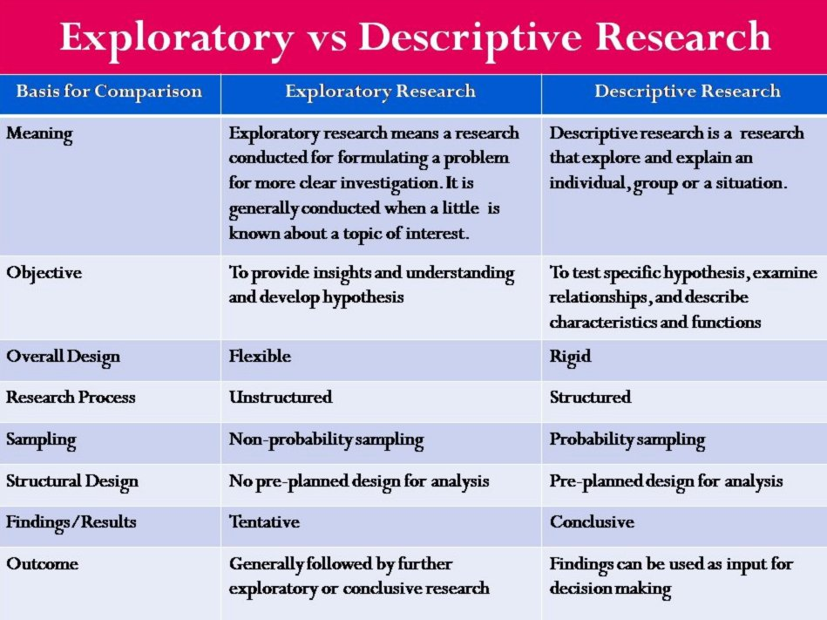

Slide 14
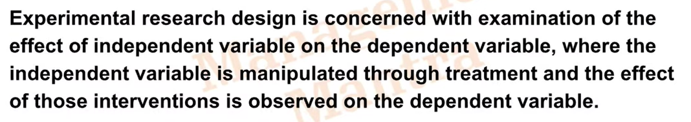
3. Experimental Research Design
Research method in which conditions are controlled so that one or more independent variables can be manipulated to test the hypothesis about dependent variables.
Allows evaluation of causal relationships among variables while other variables are eliminated or controlled.
Example: If you provide discount on the price what is its effect on sales.
Defining Experimental Research

Slide 15
The experimental research studies are mainly focused on finding out the cause and effect relationship of the phenomenon under study.
Actually, when observation is arranged and controlled, it becomes experimental study.
An experiment is a test or trial or an act or operation for the purpose of discovering something unknown or of testing a principle, supposition, etc. It is a process in which one or more variables are manipulated under conditions that permit the collection of data that show the effects of any of such variables is a unconfused fashion.
There are different types of experiments, such as : methodological, pilot study, heuristic, fact finding, boundary, simulation, theoretical, illustrative, etc.

Slide 16
Concepts relating to Experimental Research Design
1. Dependent and Independent variable.
2. Extraneous Variable: Independent variables that are not related to the purpose of the study but may affect the dependent variable. It leads to error in study.
3. Control: Minimize the influence of Extraneous variable on the study.
4. Confounded relationship: When the dependent variable is not free from Extraneous variable.
Types of Experimental Design:
Types of experimental Research Designs
Pre-Experimental Research Design
True- Experimental Research Design
Quasi Experimental Research Design

Slide 17
Types of Experimental Research Designs
1. Pre-experimental Research Design: A research study could conduct pre-experimental research design when a group or many groups are under observation after implementing factors of cause and effect of the research. The pre-experimental design will help researchers understand whether further investigation is necessary for the groups under observation.
Example:
A teacher introduces a new teaching method to one class and observes students’ performance after one month.
2. True Experimental Research Design: A true experimental research design relies on statistical analysis to prove or disprove a researcher’s hypothesis. It is one of the most accurate forms of research because it provides specific scientific evidence. Furthermore, out of all the types of experimental designs, only a true experimental design can establish a cause-effect relationship within a group.
Example:
A pharmaceutical company randomly divides patients into two groups: one receives a new medicine, while the other receives a placebo to measure the medicine’s effectiveness.

Slide 18
3. Quasi-experimental Research Design: The word “Quasi” means similarity. A quasi-experimental design is similar to a true experimental design. However, the difference between the two is the assignment of the control group. In this research design, an independent variable is manipulated, but the participants of a group are not randomly assigned. This type of research design is used in field settings where random assignment is either irrelevant or not required.
Example:
A school compares the academic performance of two existing classes where one class uses smart boards and the other follows traditional teaching methods.

Slide 19
Advantages of ERD
Researchers have firm control over variables to obtain results.
The subject does not impact the effectiveness of experimental research. Anyone can implement it for research purposes.
The results are specific.
Post results analysis, research findings from the same dataset can be repurposed for similar research ideas.
Researchers can identify the cause and effect of the hypothesis and further analyze this relationship to determine in-depth ideas.
Experimental research makes an ideal starting point. The collected data could be used as a foundation to build new research ideas for further studies.

Slide 20
Class preparation:
Which of the research design is applicable for the following topics. Explain with reasons and also draft a research design for each of the following.
Exploring the Impact of Artificial Intelligence Tools on College
Students’ Learning Habits.
2. A Study on Customer Satisfaction Towards Online Food Delivery Services.
3. Impact of Artificial Intelligence (AI)-Based Recruitment Tools on the Hiring Efficiency of Organizations.

Slide 21
Errors in Research Design
A useful way of looking at the research process is that involves the management of errors. At all stages, from problem formulation to report presentation errors can arise. It is rare that a research project will be error free. Consequently the research designer must adopt a strategy for managing and maintaining the error. We shall first look at the component of errors and then the type of errors.

Slide 22
Components of Errors in Research
Sampling Error: refers to the variable error resulting from chance selection of elements from population as per the sampling plan. Since it introduces random variability into the precision with which sample statistics are calculated it is also called random sampling error.
Non Sampling error.: consist s of all other error associated with the research project .Such errors are diverse in nature. They are oft en thought of as bias. However bias is a type of systematic error which enters into the process because of un- calibrated instruments or prejudices of the researcher.

Slide 23
Types of Errors in research
A. Sampling error
Population specification error.
Sampling Selection error
Sampling frame error
Non Response error.
Surrogate Information Error.
B . Non Sampling Error.
Measurement error
Experimental Error
Notes below
Notes:
ERRORS I N RESEARCH DESI GN
A useful way of looking at the m arketing research process is that involves the m anagement of er- rors. At all stages, from problem form ulation to report presentation
– errors can arise. I t is rare that a research project will be error free. Consequently the research de- signer m ust adopt a strategy for m anaging and m aintaining the error. We shall first look at the com ponent of errors and then the type of errors.
COMPON EN TS OF ERRORS
The objective underlying any re- search project is to provide infor- m ation that is to be accurate and error free as possible. Maximising accuracy requires that “ total er- ror” be m inim ised. Total error has two distinct components:
Total Error = Sampling Error + Non Sampling Er ror
Total error is usually m easured as total error variance – also know as the m ean squared error:
( Total Error) ² = ( Sampling Error) ²
+ ( Non Sampling Error) ²
Sam pling Error refers to the variable error resulting from chance selection of elem ents from population as per the sampling plan. Since it introduces random variability into the precision with which sam ple statistics are calcu- lated it is also called random sam - pling error. N on Sam pling Error consists of all other error associ- ated with the research project. Such errors are diverse in nature. They are often thought of as bias. However bias is a type of system - atic error which enters into the process because of un- calibrated instrum ents or prejudices of the researcher. There can be com - pletely random components of non- sam pling error. For example a m isrecording of a response during data collection represents a ran- dom non- sam pling error. However using deliberate “ loaded” question to get desired response – which m aintaining the status quo of ran- dom ness – is called bias. Thus non- sam pling errors can arise from various sources – but in m arketing research project they arise m ainly from response and non- response.
To a large extent the m ajor error com ponents are related to each other in an inverse m anner. I n- creasing the sample size to reduce the sam pling error can lead to an increase in non- sam pling error. I n m ost statistical projects – the ef- fort is to minimise the total error by m inim ising the sampling error and assum ing that good training of the investigators will reduce the non- sam pling error. However in m arket research that m ay not be the possible as the t im e and cost constraints m ay prevent choosing a sam ple size which will allow us to be confident that the sampling error ( and hence total error) has been m inim ised. I deally a market researcher should strive to m ini- m ise both the types of error. Con- sidering the tim e and cost lim ita- t ions this can rarely be done. The m arket researcher m ust m ake a decision that involves a t rade off between sampling and non- sam pling errors. Unfortunately very lit t le is known about the rela- t ive size of two error components
– although som e empirical evi-
dence suggests that non- sampling errors tend to be larger of the two com ponents. Sampling errors can to a large extent be reduced and/ or controlled by following statistical procedures, but such a check is generally not possible on non- sam pling errors
TYPES OF ERRORS:
Populat ion Specificat ion Error: I t is defined as the “ non correspondence of the required population to the population selected by the in- vestigator” . I t occurs when a researcher selects an inap- propriate population from which to obtain data. For example m any t im es package goods m anufacturers conduct surveys am ongst housewives
– because they are easy to contact and because it is as- sum ed that as they are the end users they m ake the pur- chase decisions. This assum p- t ion m ay not be always valid since husbands and children m ay significantly influence the buying decisions.
Sam pling Error: I t is defined as the “ non correspondence of sam ple selected by prob- ability m eans and the repre- sentative sam ple selected by the researcher” . I t occurs when a probability sam pling m ethod is used to select a
sam ple and this sam ple is not representative of the popula- t ion concerned. For exam ple, a random sample of 500 peo- ple composed only of people between 35- 50 years of age m ay not be representative of adult population. Sam pling error is affected by the hom o- geneity of the population un- der study. I n general – m ore hom ogenous the population; the sm aller the sampling er- ror. Sampling error falls to zero in case of a census.
Select ion Error : I t is defined as the “ Non correspondence of sample selected by non probability m eans and the representative sam ple sought by the researcher.” I n other words – it is a sampling error for the sam ple selected by non- probability m ethods. There is a natural tendency for the investigator to select those respondents who are m ost accessible and agree- able. Such sam ples are often com prised of fr iends and as- sociates who more or less represent the desired popula- tion. Sam ples of this type m ay not be representative of the population but are cer- tainly not selected random ly – leading to statistical problems in inferencing.
Fram e Error: I t is defined as the non- correspondence of the sought sam ple with the required sam ple. A sampling frame is a m eans of account- ing for all the elem ents of the population. I t is usually a list - ing of all the elements that identify a population. A per- fect fram e identifies each population only once and does not include elem ents of other population, which m ay lead to overlap. For example a sam- pling fram e that specifies the population as all adults using oral care products – m ay well leave out people who prefer using neem and babool st icks, hom em ade toothpaste and powders – leading to a frame error in defining the popula- tion.
5 . N on Response Error: A non- response error occurs, when the obtained sample differs from the original selected sam ple. Non response can oc- cur in two ways – ( a) Non- Contact i.e. the inability to
contact all the m em bers of the sam ple and ( b) Refusal
i.e. the non- response of some or all the item s of the m eas- urem ent instrum ent.
Non- contact errors arise due to the inability to reach the respondent. This m ay be be- cause the respondent is NAH ( Not at Home) on the initial call ( or call backups) or m ay have m oved away from the area either perm anently or for the period of the survey. Non Contact errors can be reduced by careful analysis of the se- lected sam ple.
Refusal arises when the re- spondent does not respond to a particular item or to m ulti- ple item s of the question- naire. Monthly Household I n- com e, Religion, Sex and Poli- t ics are topics that m ay elicit item refusal – norm ally cate- gorised as refused. Don’t Know / Can’t Say ( DKCS) re- fusals arise when the respon- dent is aware of the item but is unable to provide an ade- quate answer to the item . Constraints of t im e on the part of the respondent, a bad experience with som e previ- ous interviewer, ill health etc. m ay be other reason for re- fusal. Refusal rates could be brought down to m anageable levels by giving t raining to the interviewers and continuously m onitoring the investigation process.
Surrogat e I nform at ion Er- ror: This is defined as the non- correspondence of the in- form ation being sought by the researcher and that is re- quired to solve the problem. Or in other words, inform ation is obtained from substitutes rather than original sam ple. The necessity to accept sur- rogate inform ation arises from either the inability or the unwillingness of the respon- dent to provide the needed inform ation.
Decisional oriented behav- ioural research is always con- centrated with prediction of behaviour usually non- verbal. This lim its m ost m arketing re- search projects to use proxy inform ation – data from past behaviour. Attitudes, beliefs and SEC classification are all exam ples of surrogate infor-
m ation because based on these inform ation we try to predict the future behaviour of the respondents. Secon- dary sources of data are an- other source of surrogate in- form ation. Surrogate inform a- t ion error can be m inim ised by ensuring that the inform a- t ion used is highly correlated with the actual inform ation obtained.
Measurem ent Error: This m ay be defined as the non- correspondence of inform a- t ion obtained by measure- m ent process and the infor- m ation sought by the re- searcher. I t is generated by the m easurem ent process it - self and represents the differ- ence between inform ation generated and inform ation wanted by the researcher. Such errors can potentially arise at any stage of the m easurement process – from the development of the in- strum ent t ill the analysis of findings.
The error can also occur at transm ittal stage - when the interviewer is questioning the respondent. Faulty wording of question, non- preparation of non- verbal clues, behaviour of the interviewer etc m ay all contribute to how the respon- dent interprets the question.
I n the response phase – when the respondent is replying – error m ay occur because the respondent gave a wrong an- swer or the correct answer was wrongly interpreted and recorded. I n the analysis phase, errors of incorrect editing, coding and/ or descriptive sum m arisation and inferences can contribute substantially to m easurement error.
Experim ental Error: It can be defined as the non- correspondence of the “ t rue im pact of” and the “ impact at- t r ibuted to” the independent variable. When an experiment is conducted, the researcher attem pts to m easure the im - pact of one or m ore m anipu- lated independent variable on som e dependent variable – while controlling the im pact of exogenous variable. Unfortu- nately control over all the ex- ogenous variable is not al- ways possible – which m ay
lead to an inclusion of bias in the experiments. For exam ple a study – t rying to find out reasons for cancer m ay con- clude that as all the patients under observation used to eat bread therefore eating bread is the cause of cancer.
CON CLUSI ON
For any research project, recognising that potential error exists is one thing – but doing som ething about it quite another m atter.
There are two basic approaches for reducing errors.
The first is to m inim ise errors through research design. In this process effective use of research m ethods and techniques are util- ised to lessen the im pact of both sam pling and non- sam pling er- rors. However, cost constraints, and at t im es the peculiar nature of error they prevent complete m inim isation of error through this method.
The second is to est im ate and m easure error. I n spite of all the precautions undertaken, not all errors – especially those related to fieldwork – would be elim inated. I n such a situation if we can have an estim ate of error we can say how accurate the research design was. However only sampling er- rors are measurable with som e degree of confidence.
Either way, estim ating is not an easy task due to the peculiar na- ture of the errors. Statistics help us to reduce the sampling error to a large degree but for non- sam pling error researchers st ill have to rely on their intuition.

Slide 24
Thank You

